Slide 1

TURNITIN FOR STUDENTS
Part 3 - Academic misconduct
SOLENT UNIVERSITY - COMPUTING SUBJECT GROUP

Slide 2

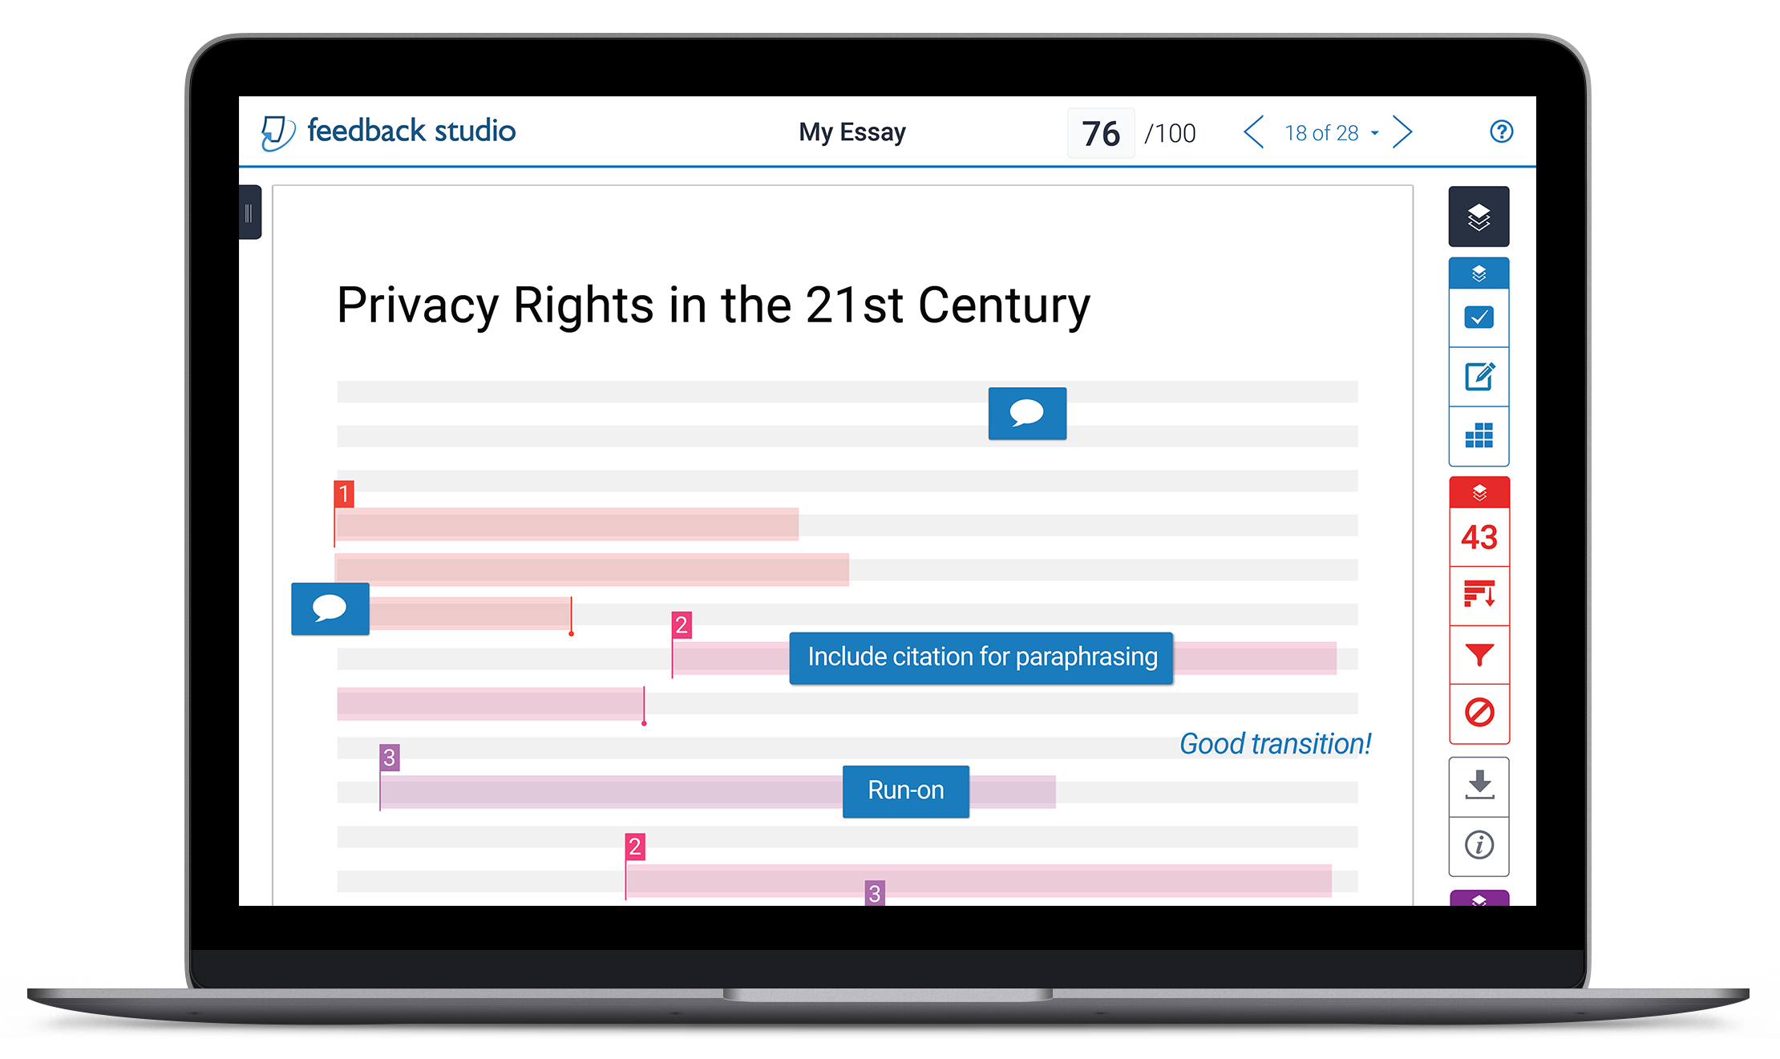
TURNITIN., 2020. Feedback Studio [viewed 29 April 2020]. Available from: https://www.turnitin.com/products/feedback-studio

Slide 3
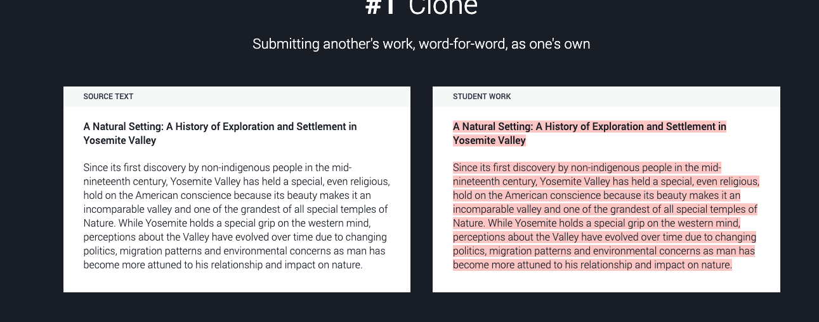

Slide 4
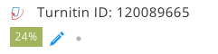
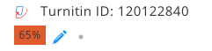
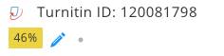
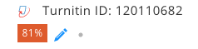

Slide 5
Does academic misconduct have to be intentional?
It is important to note that whether academic misconduct is intentional or unintentional, it is still likely to be deemed academic misconduct. Examples of unintentional academic misconduct are given below:
Poor understanding or incorrect referencing.
Confusion around paraphrasing.
Cultural differences in academic writing and referencing.
Fear of asking questions regarding the correct procedure for referencing.

Slide 6
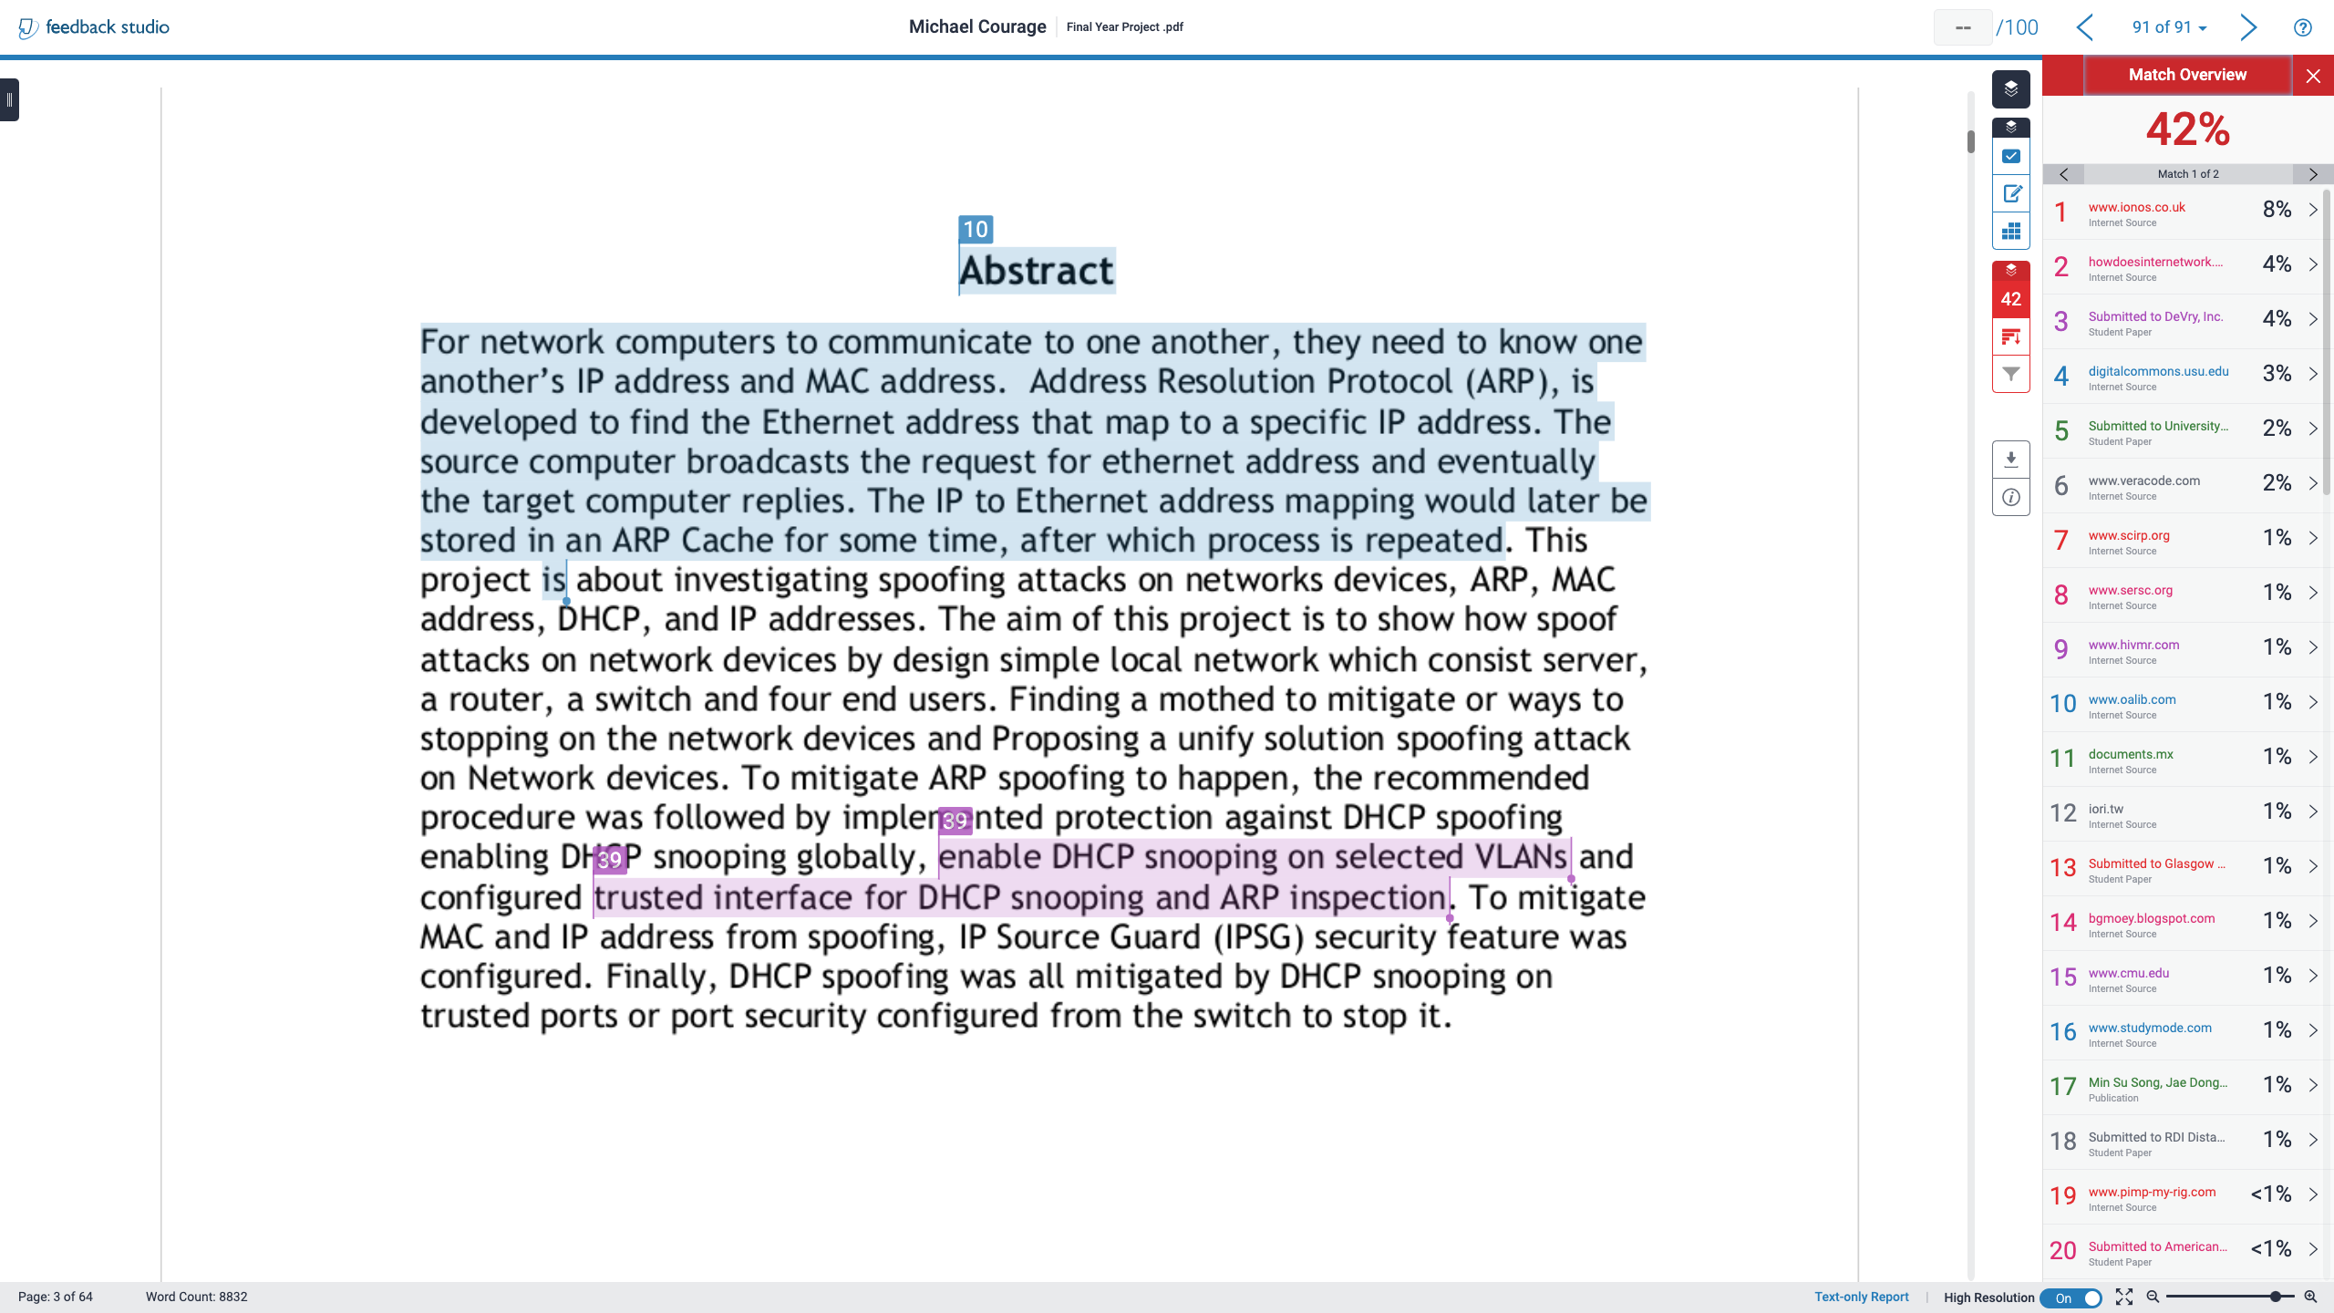

Slide 7
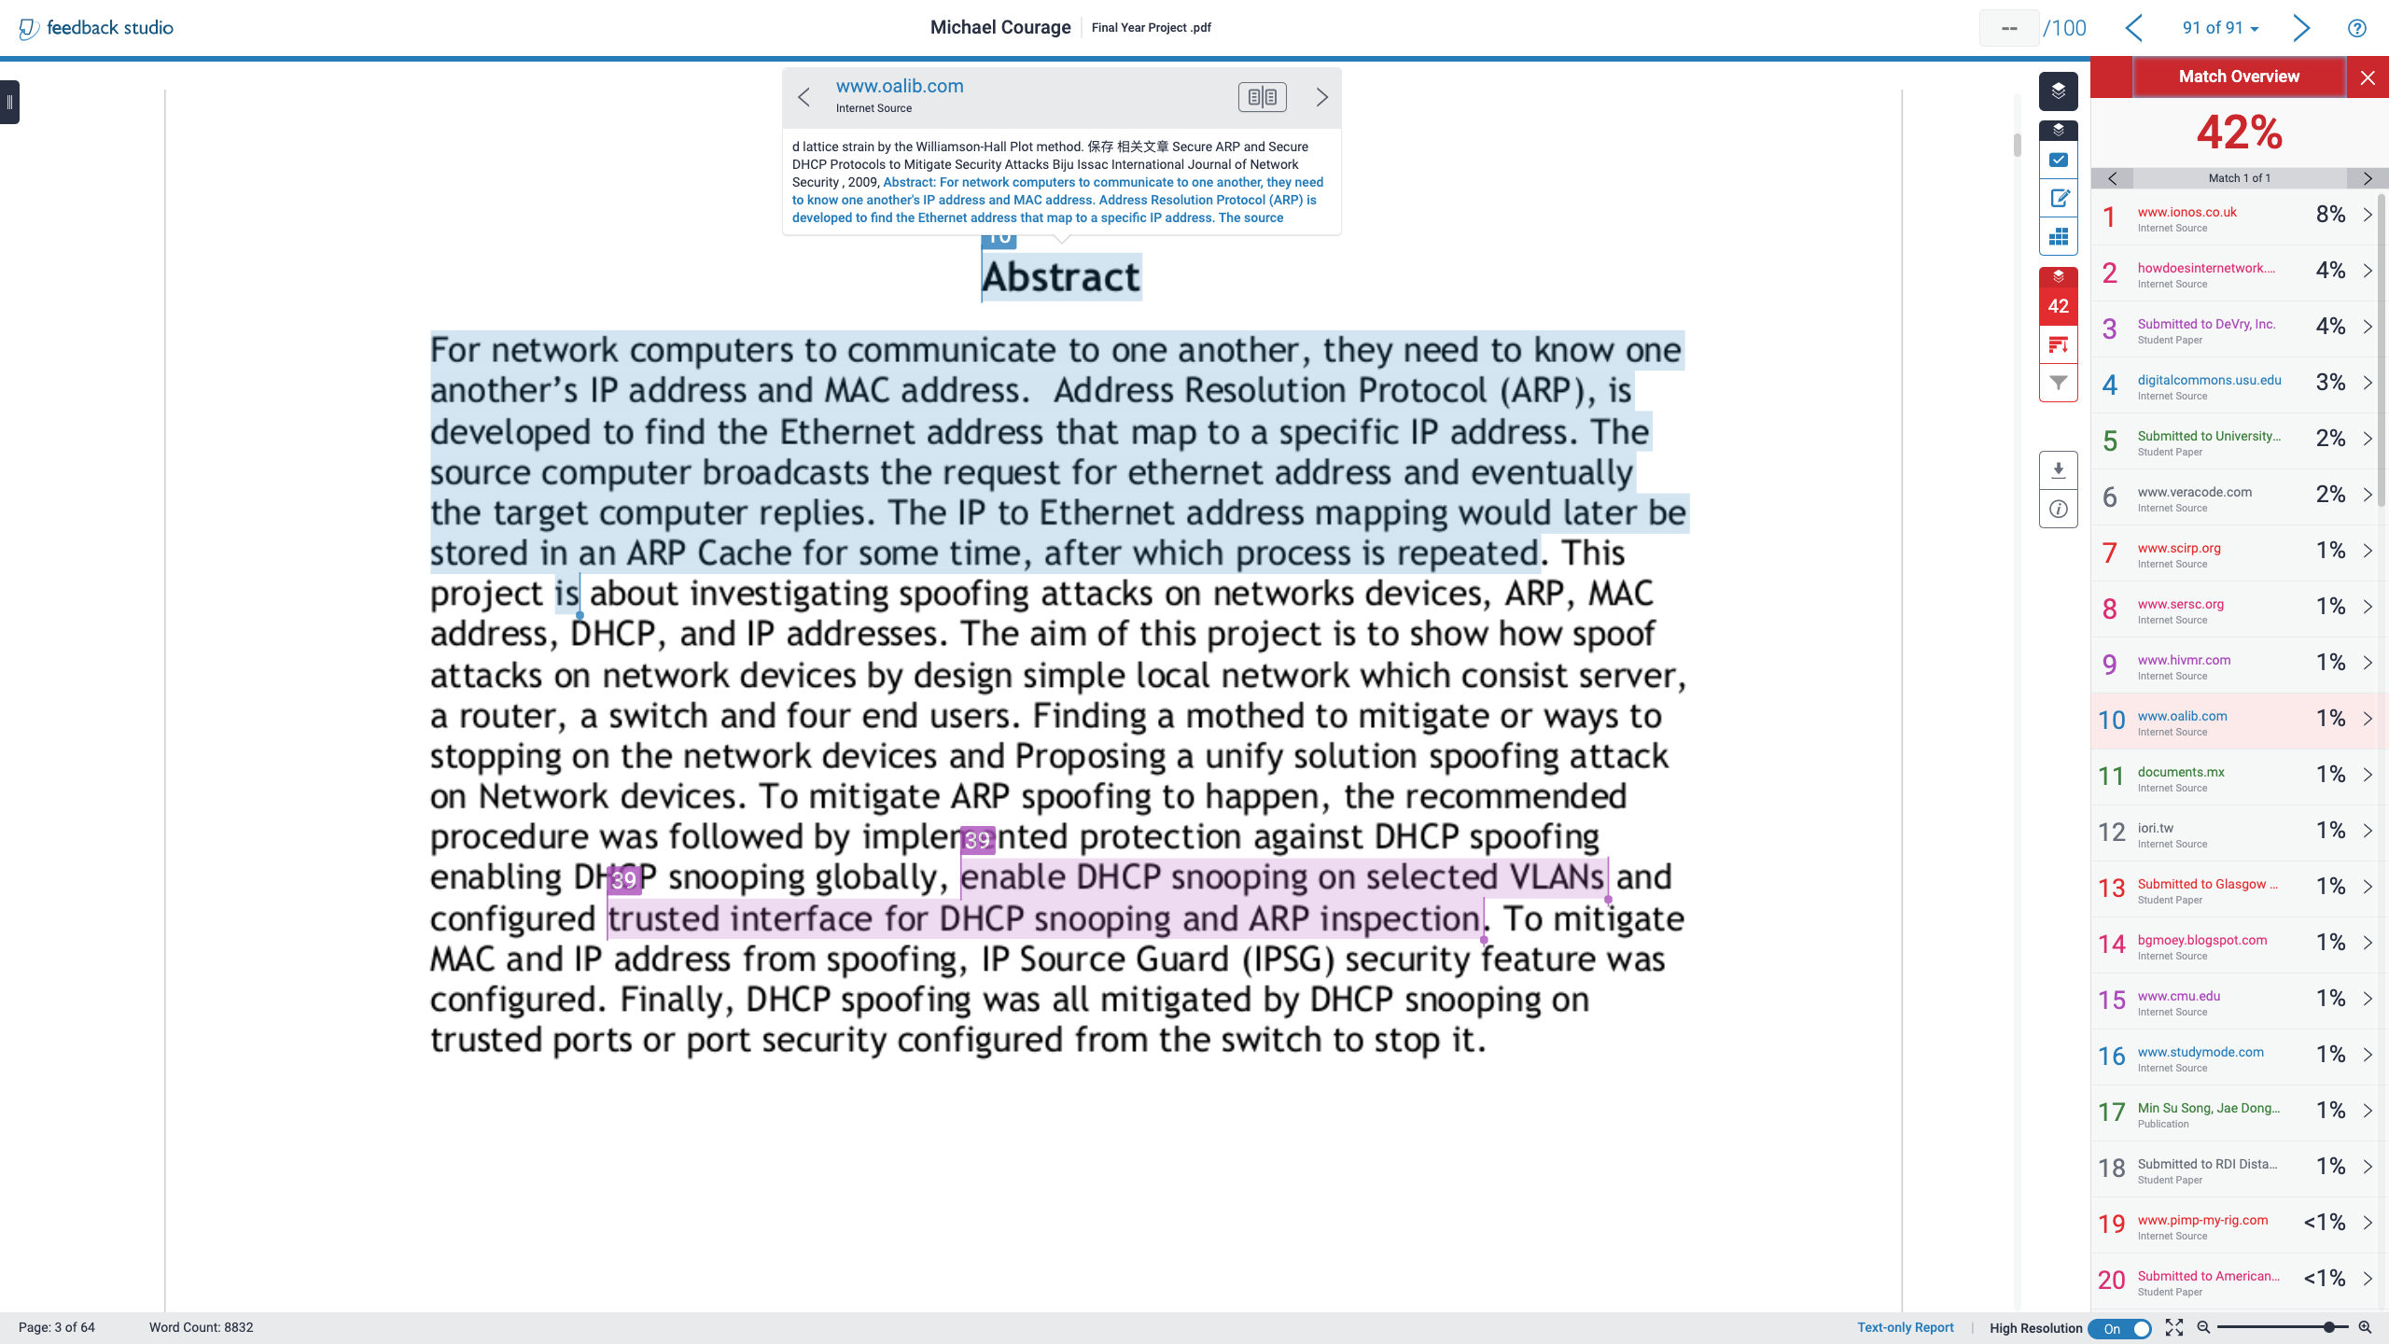

Slide 8
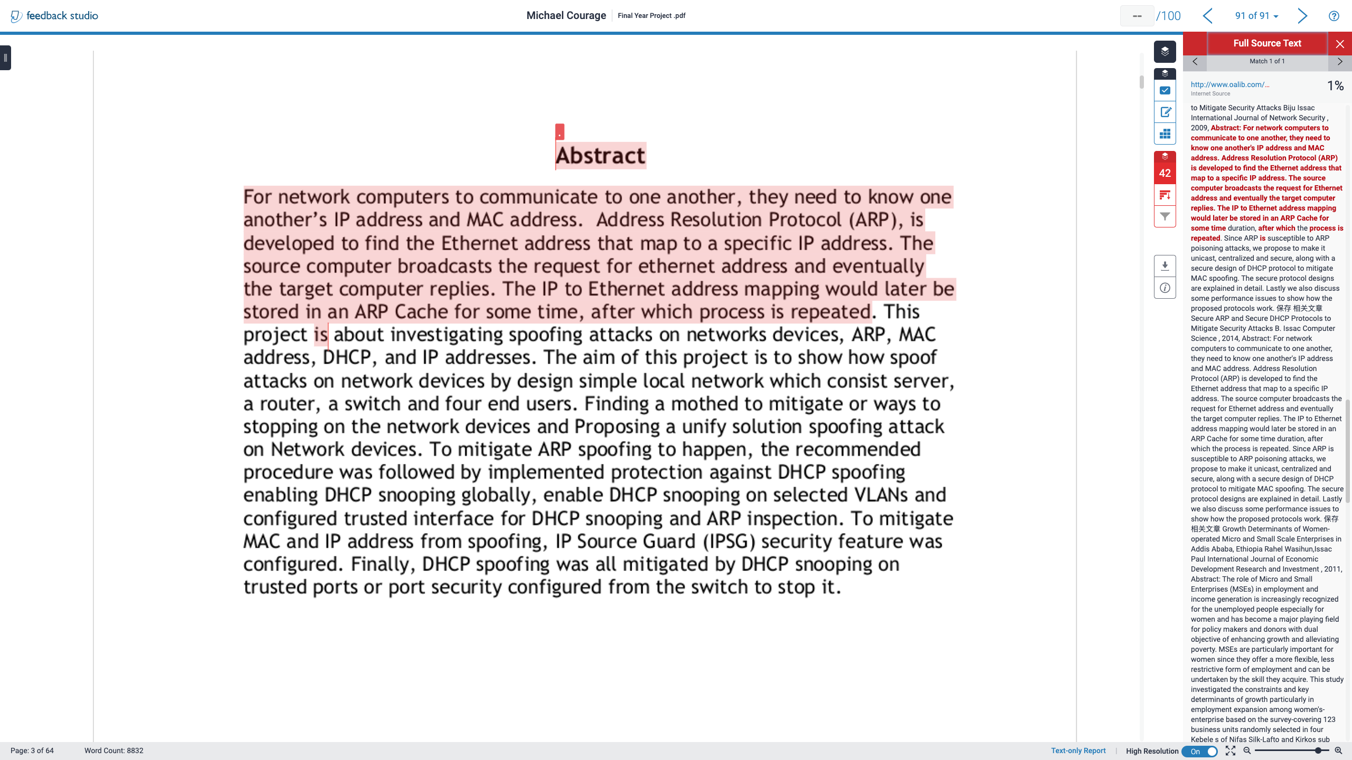

Slide 9
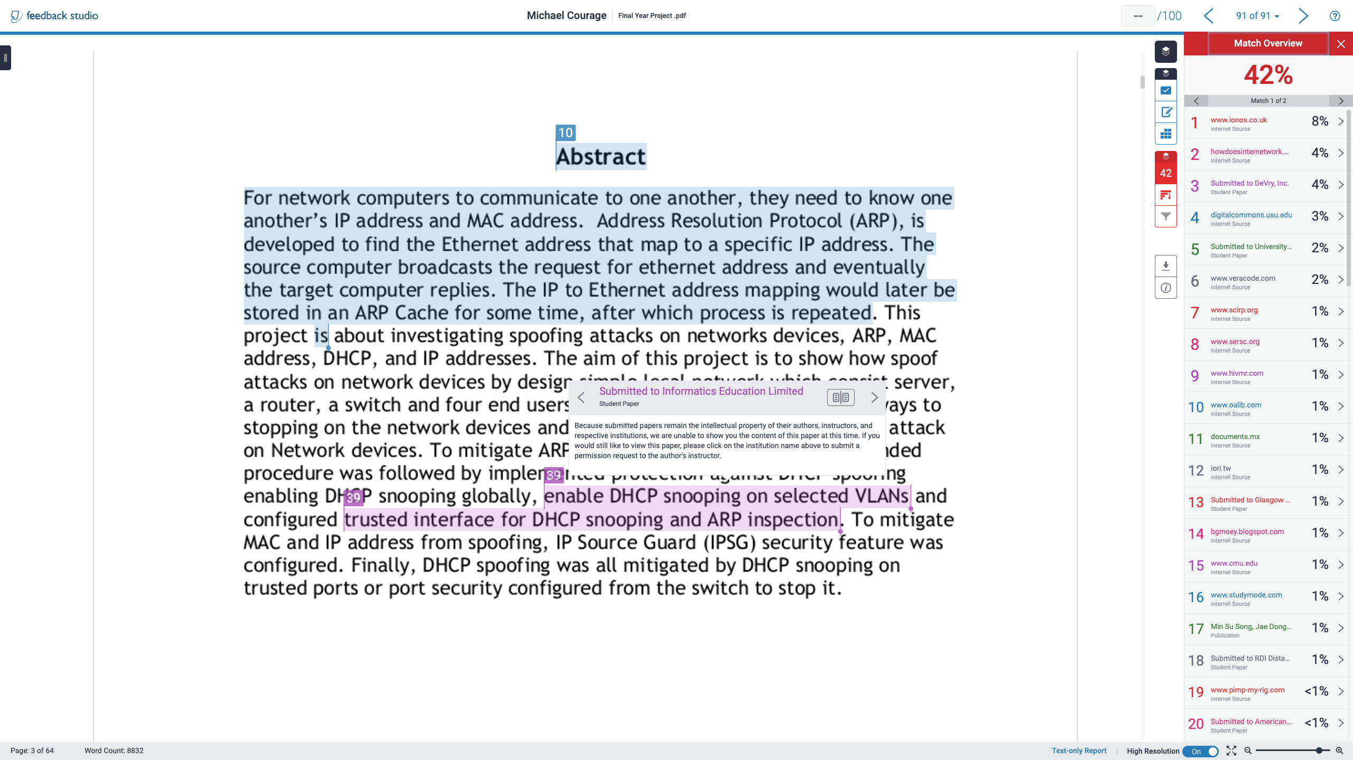

Slide 10
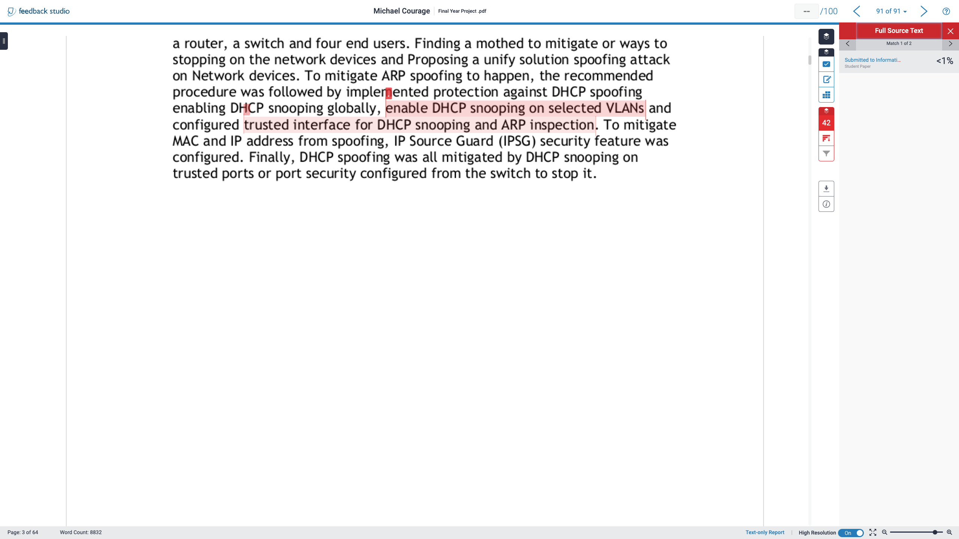

Slide 11
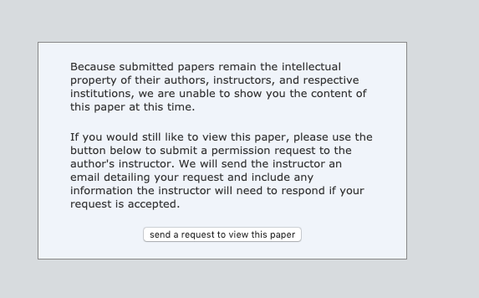

Slide 12
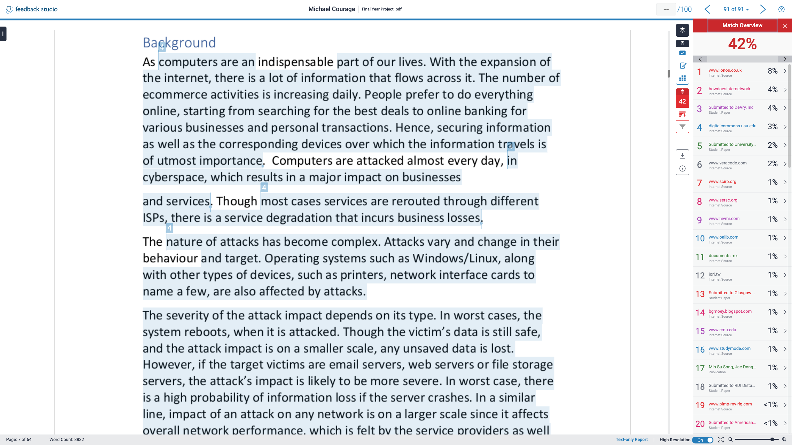

Slide 13
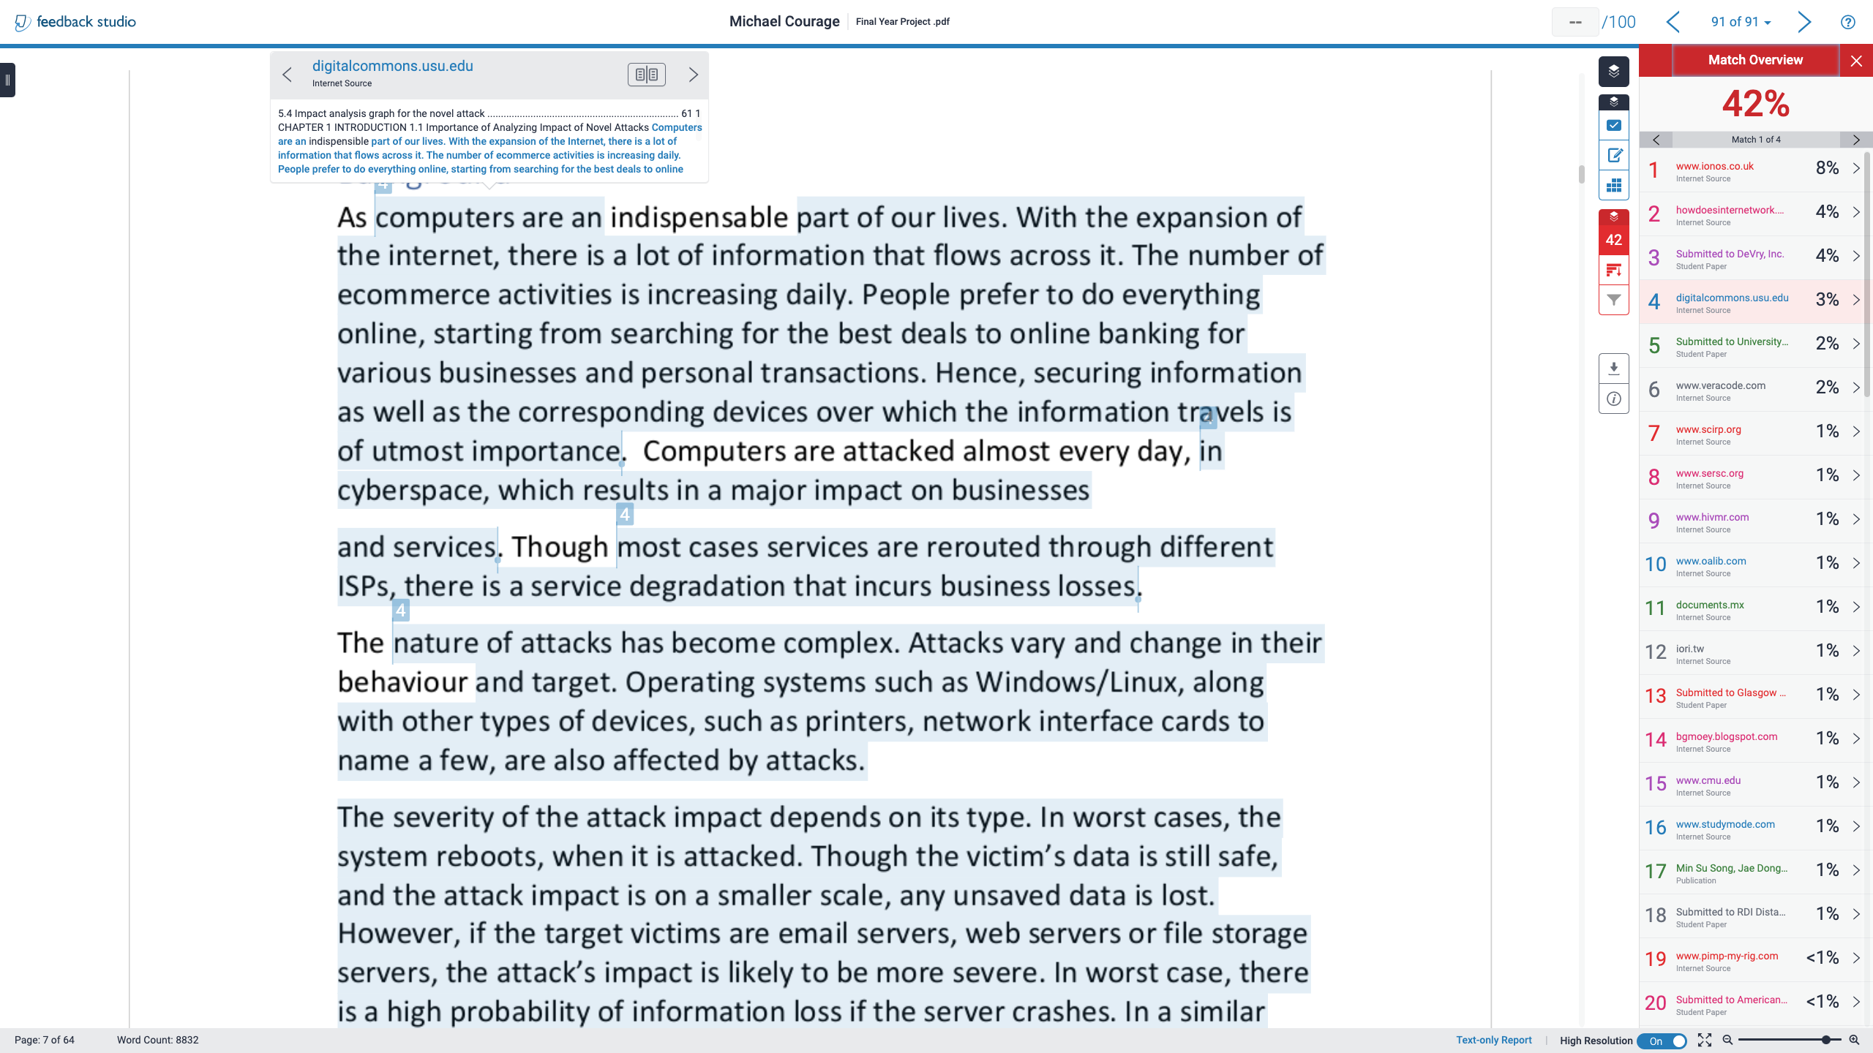

Slide 14
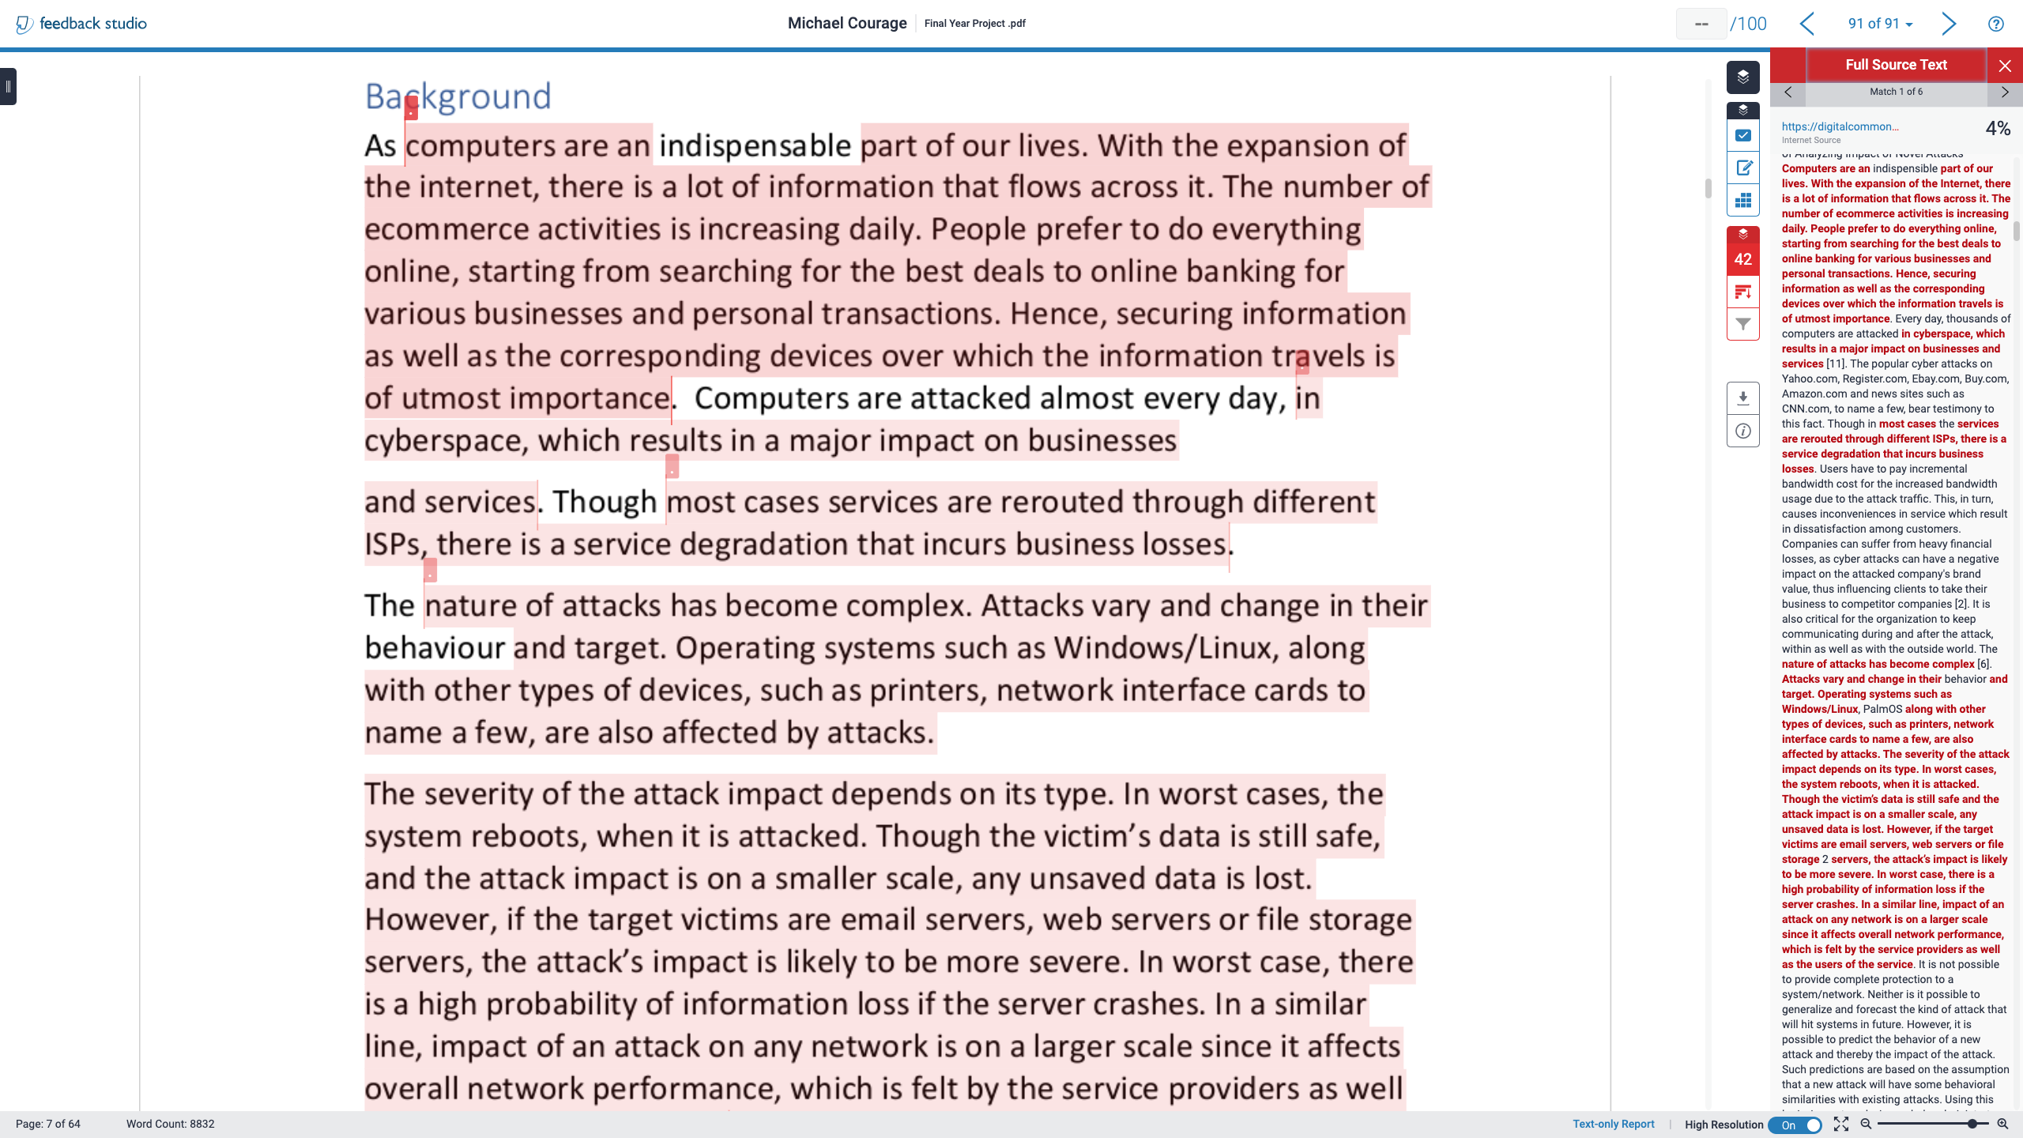

Slide 15
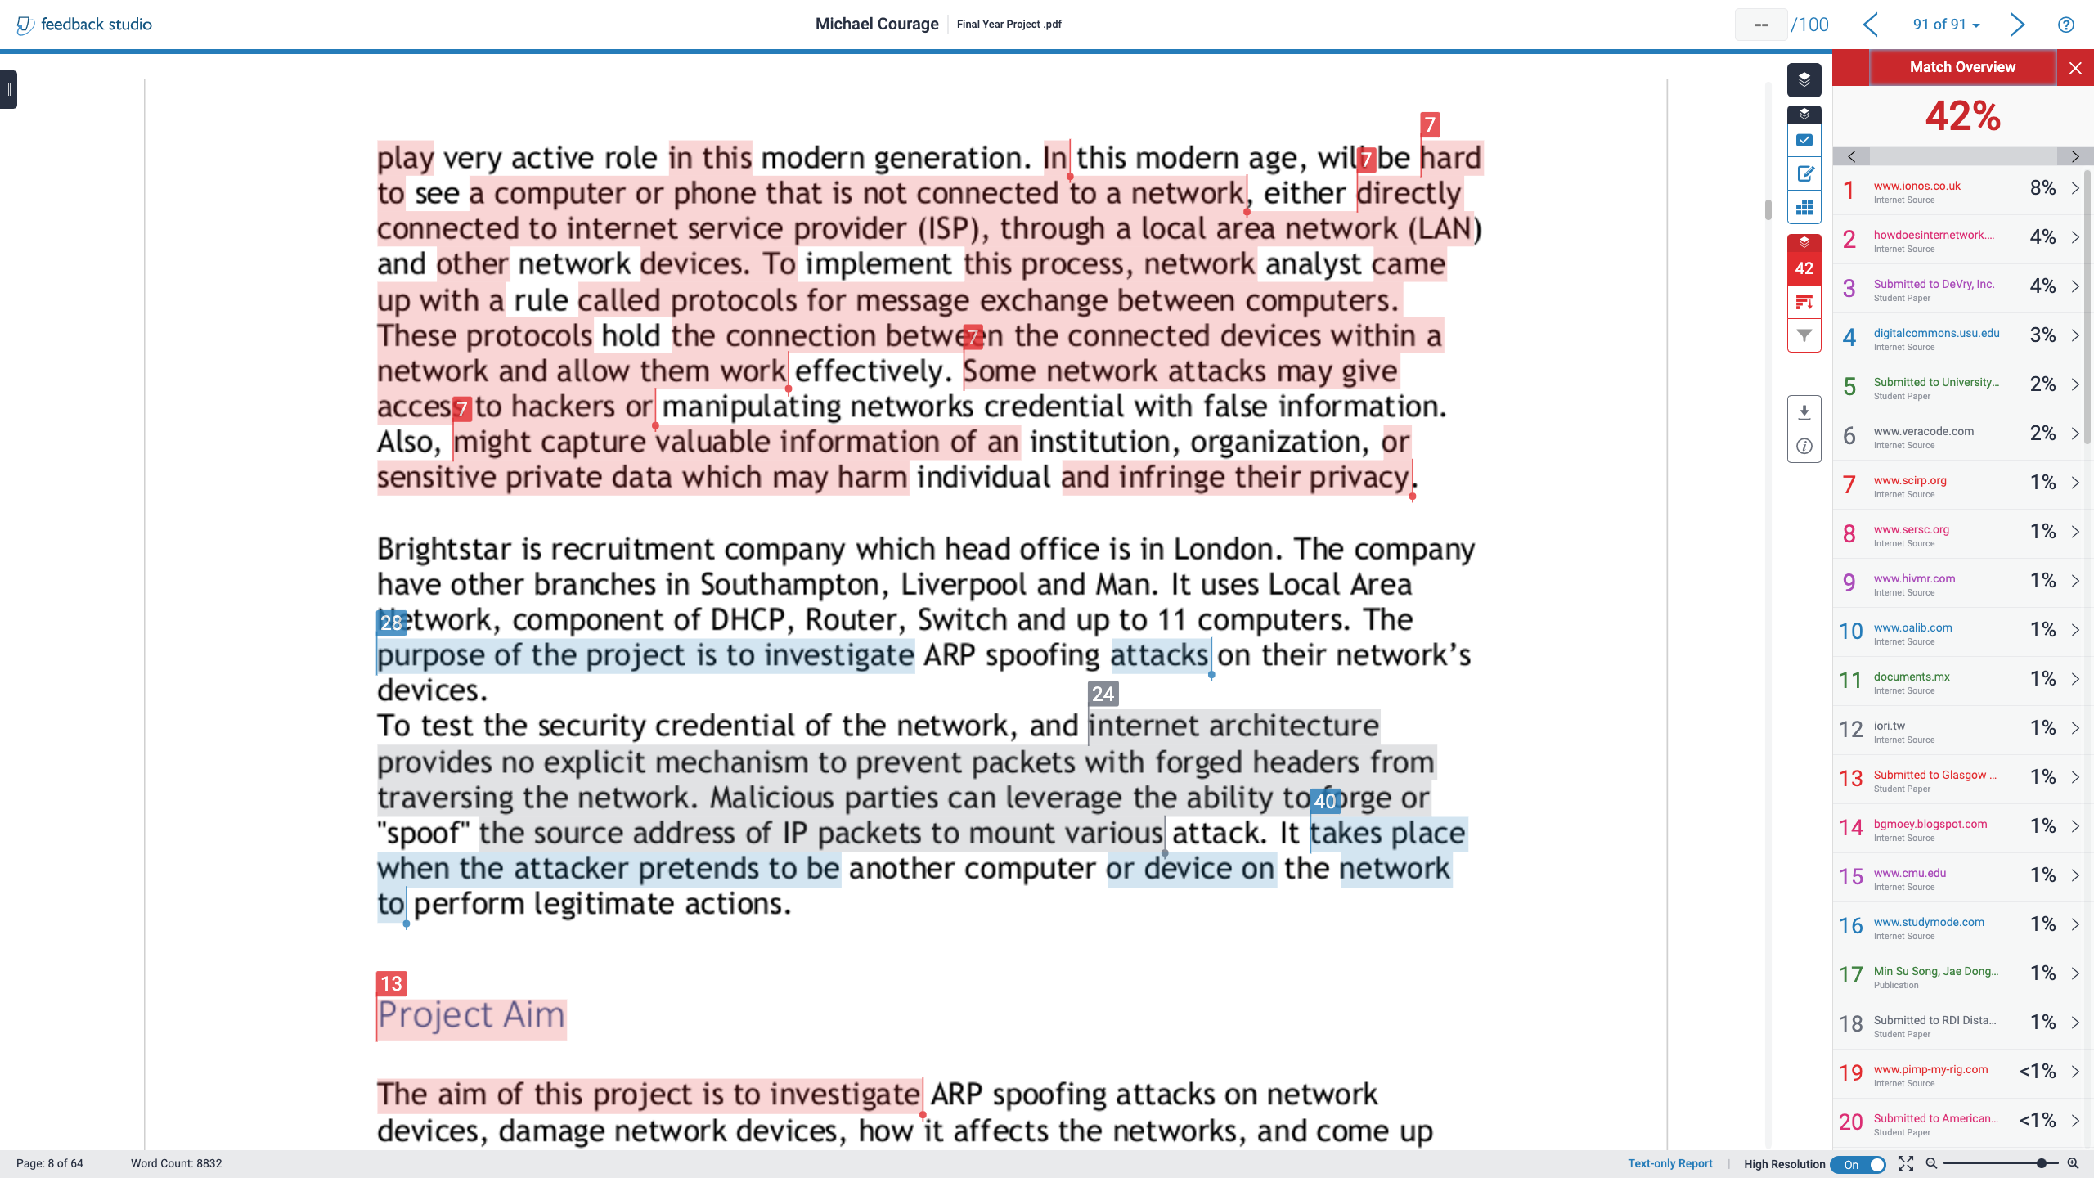

Slide 16
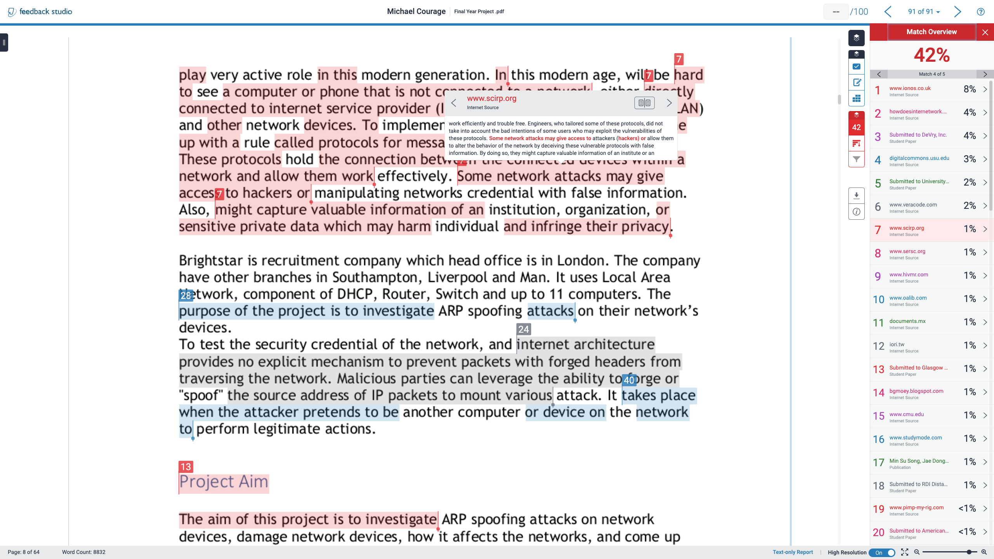

Slide 17
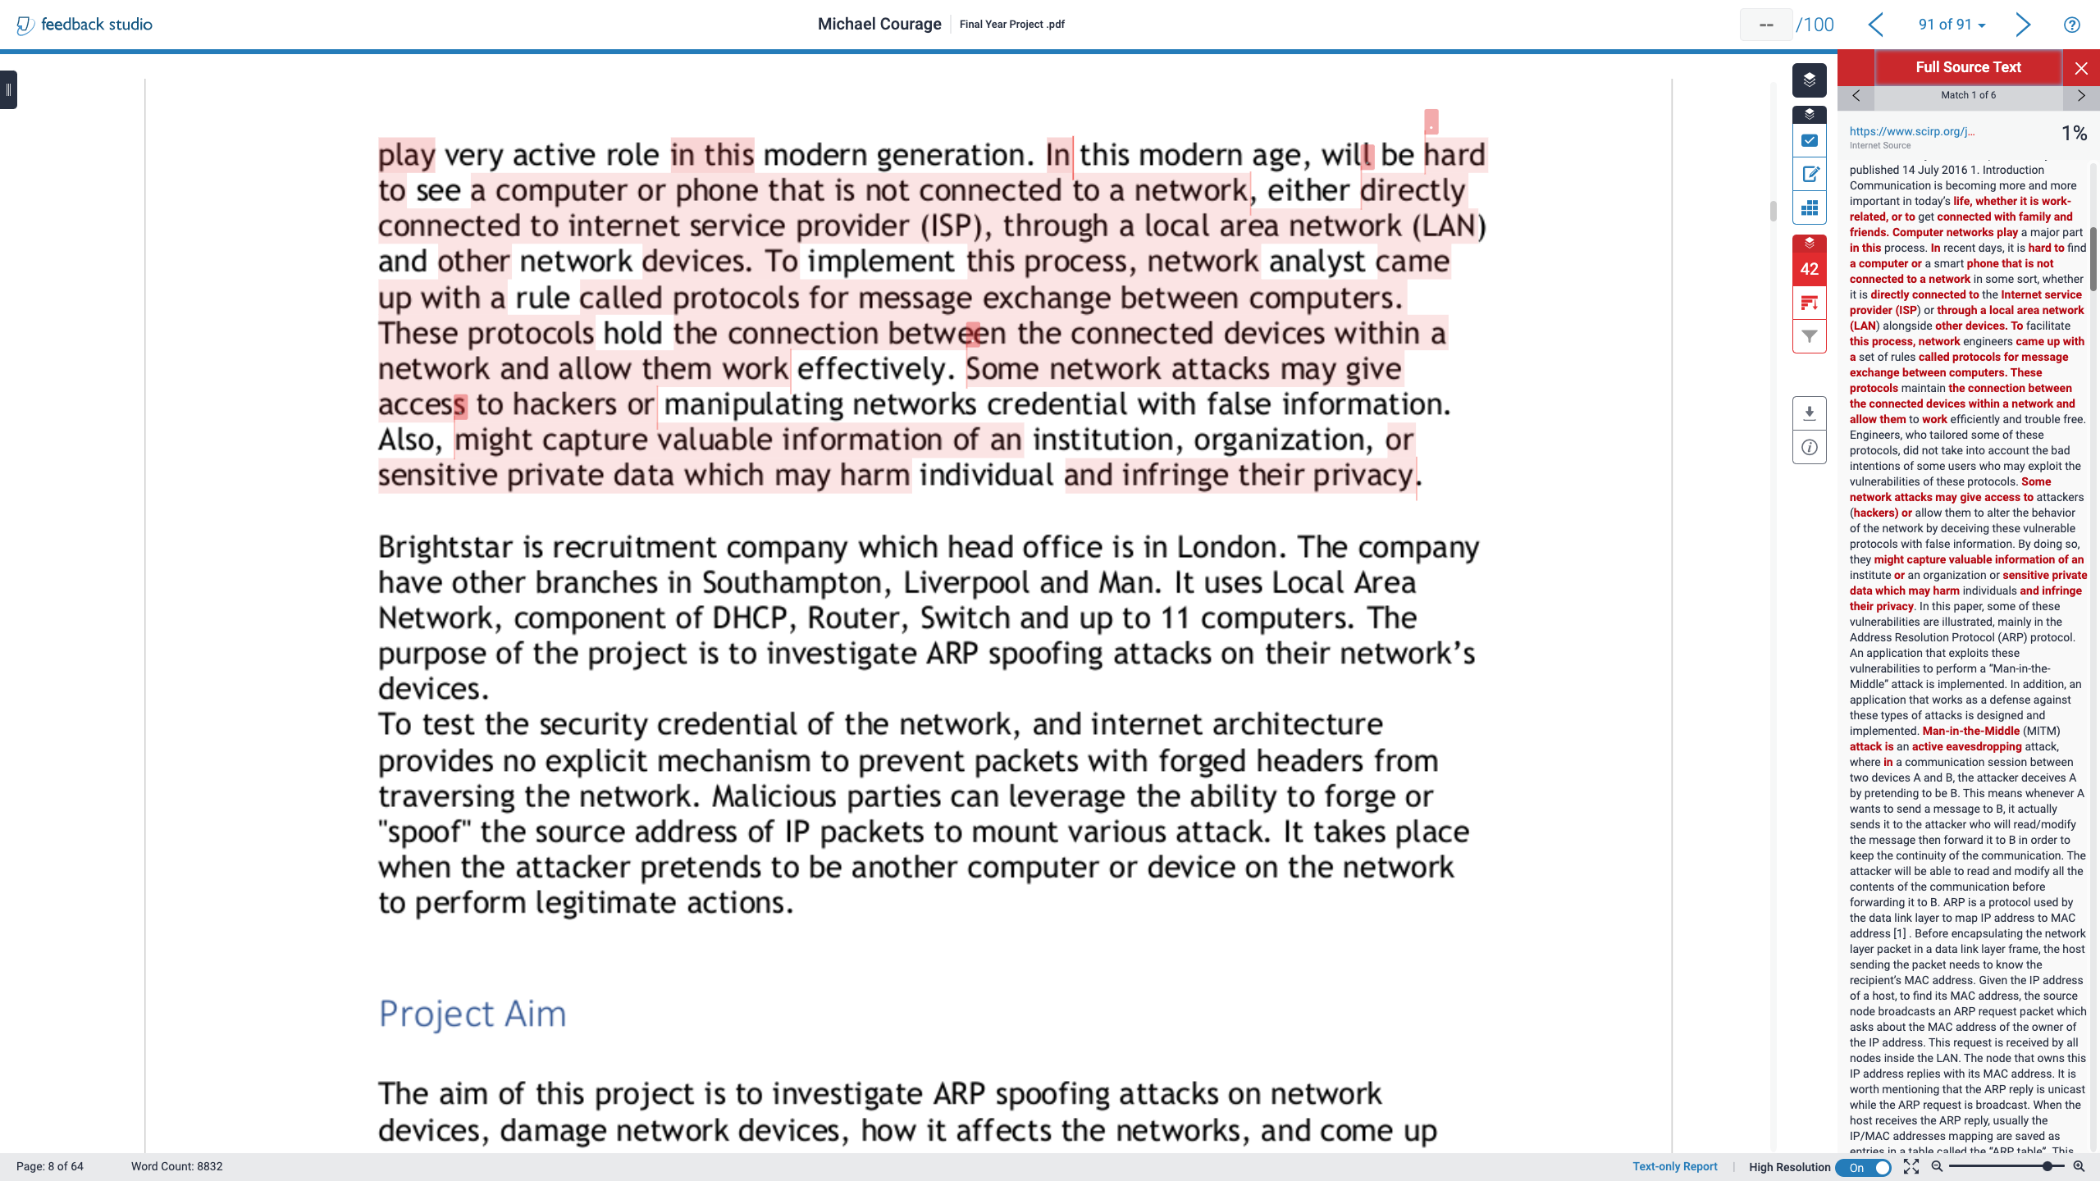

Slide 18
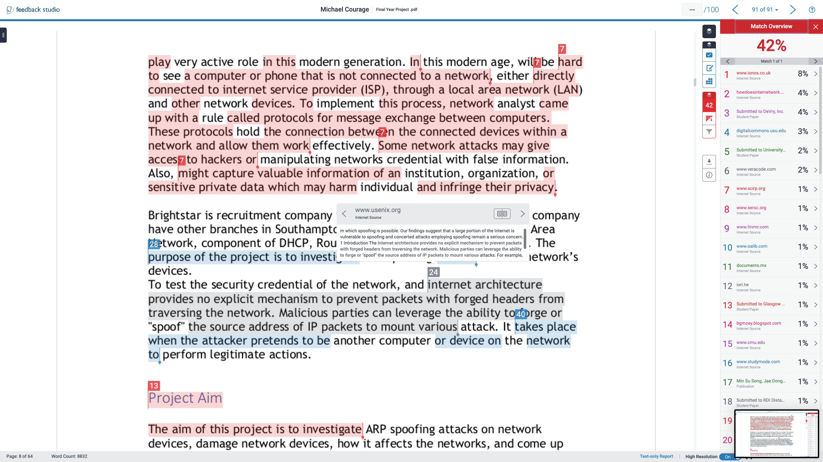

Slide 19
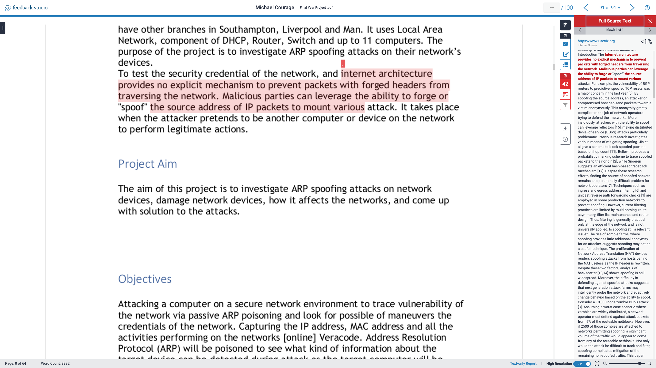

Slide 20
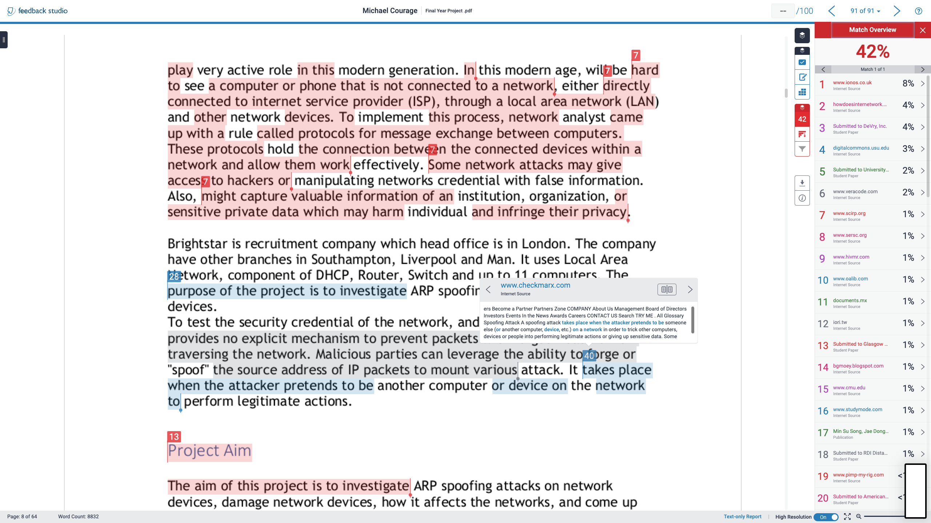

Slide 21
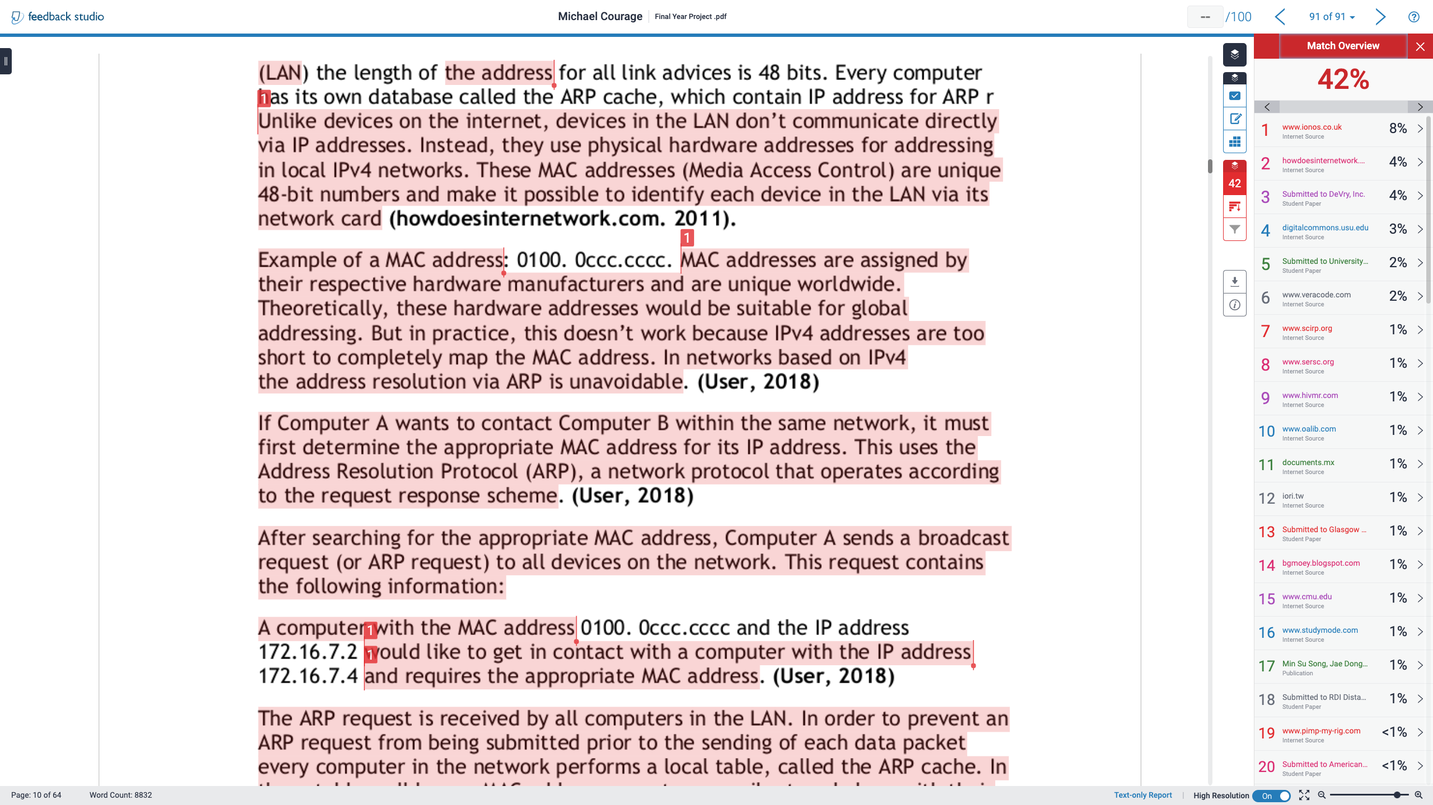

Slide 22
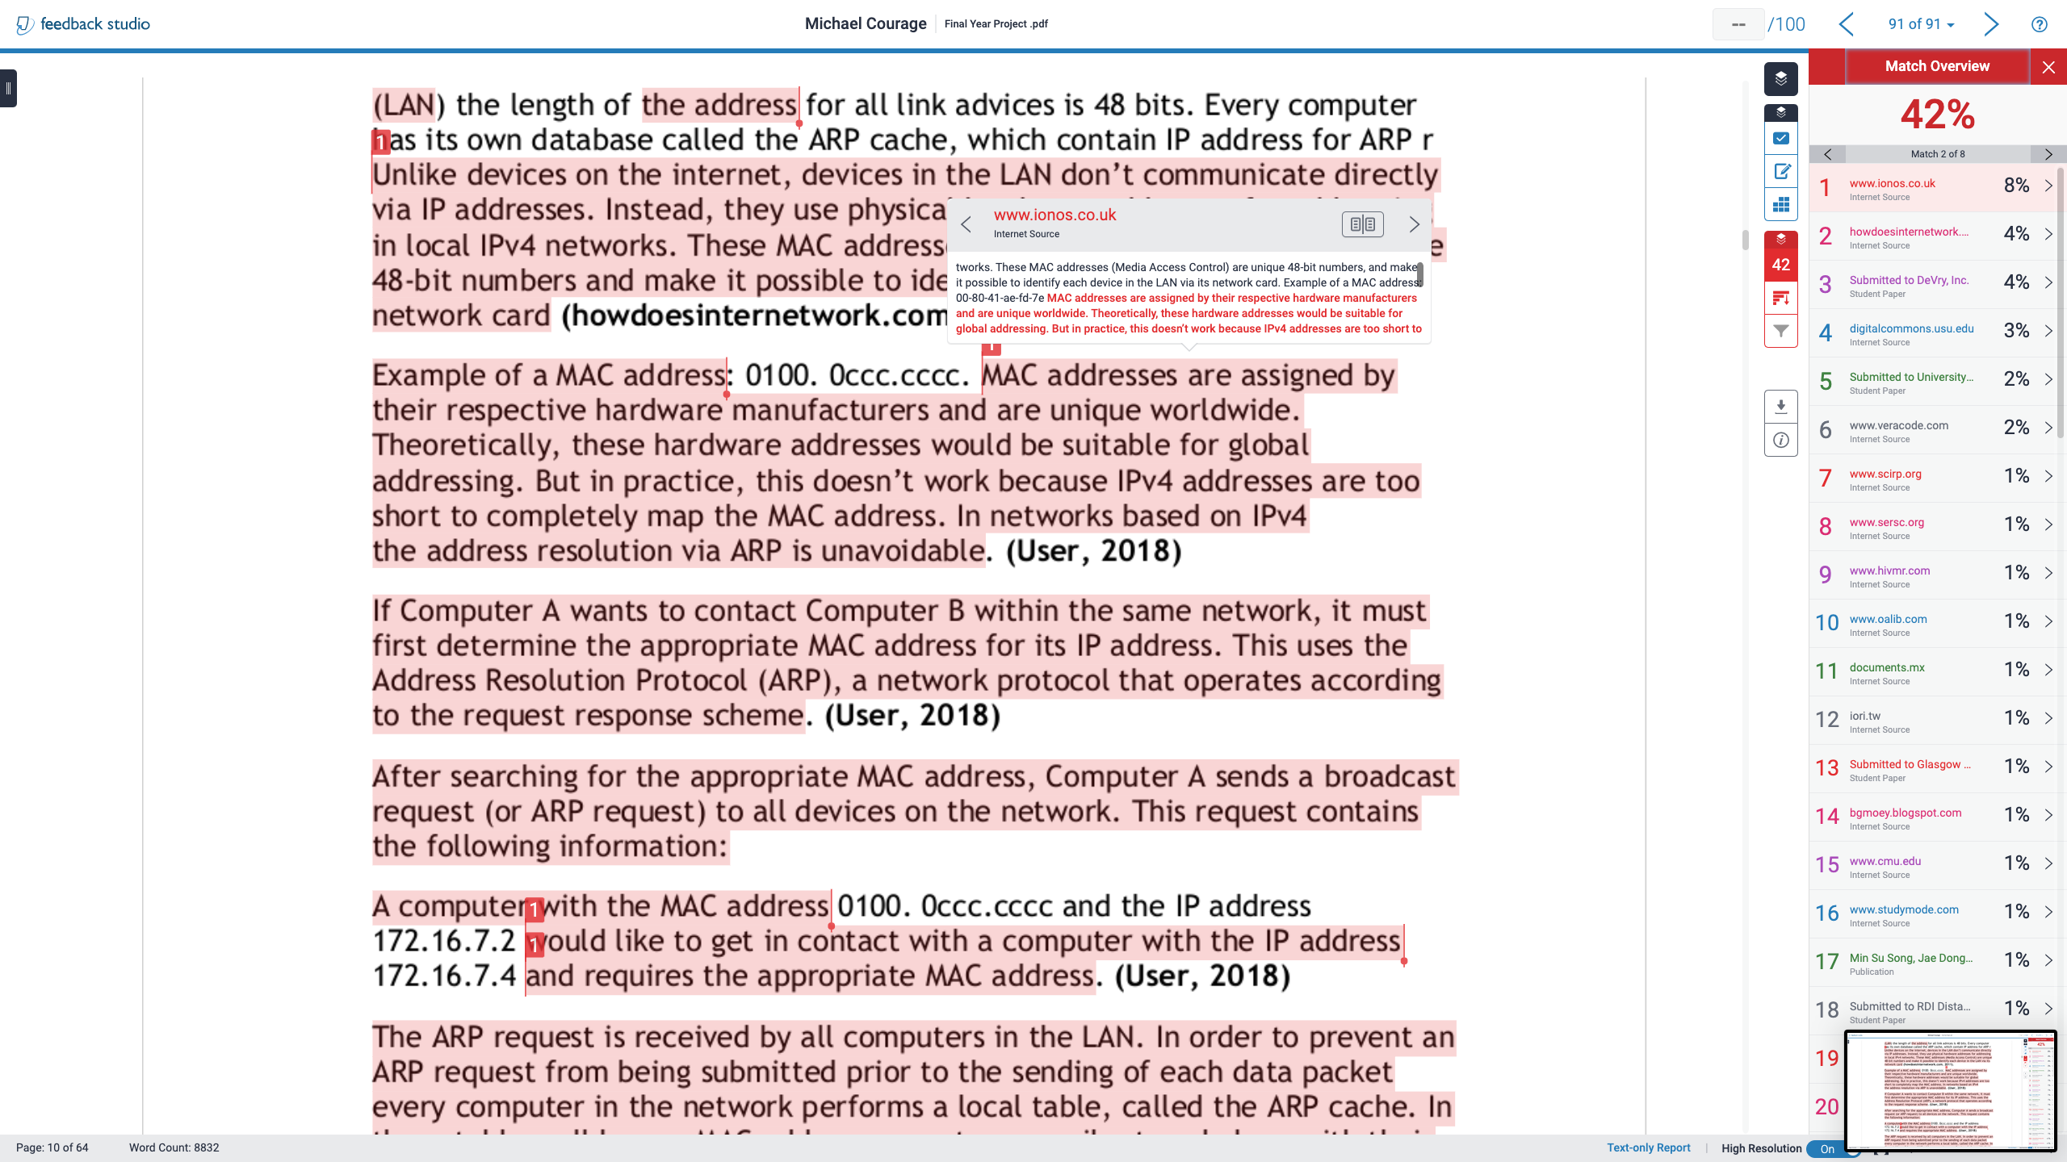

Slide 23
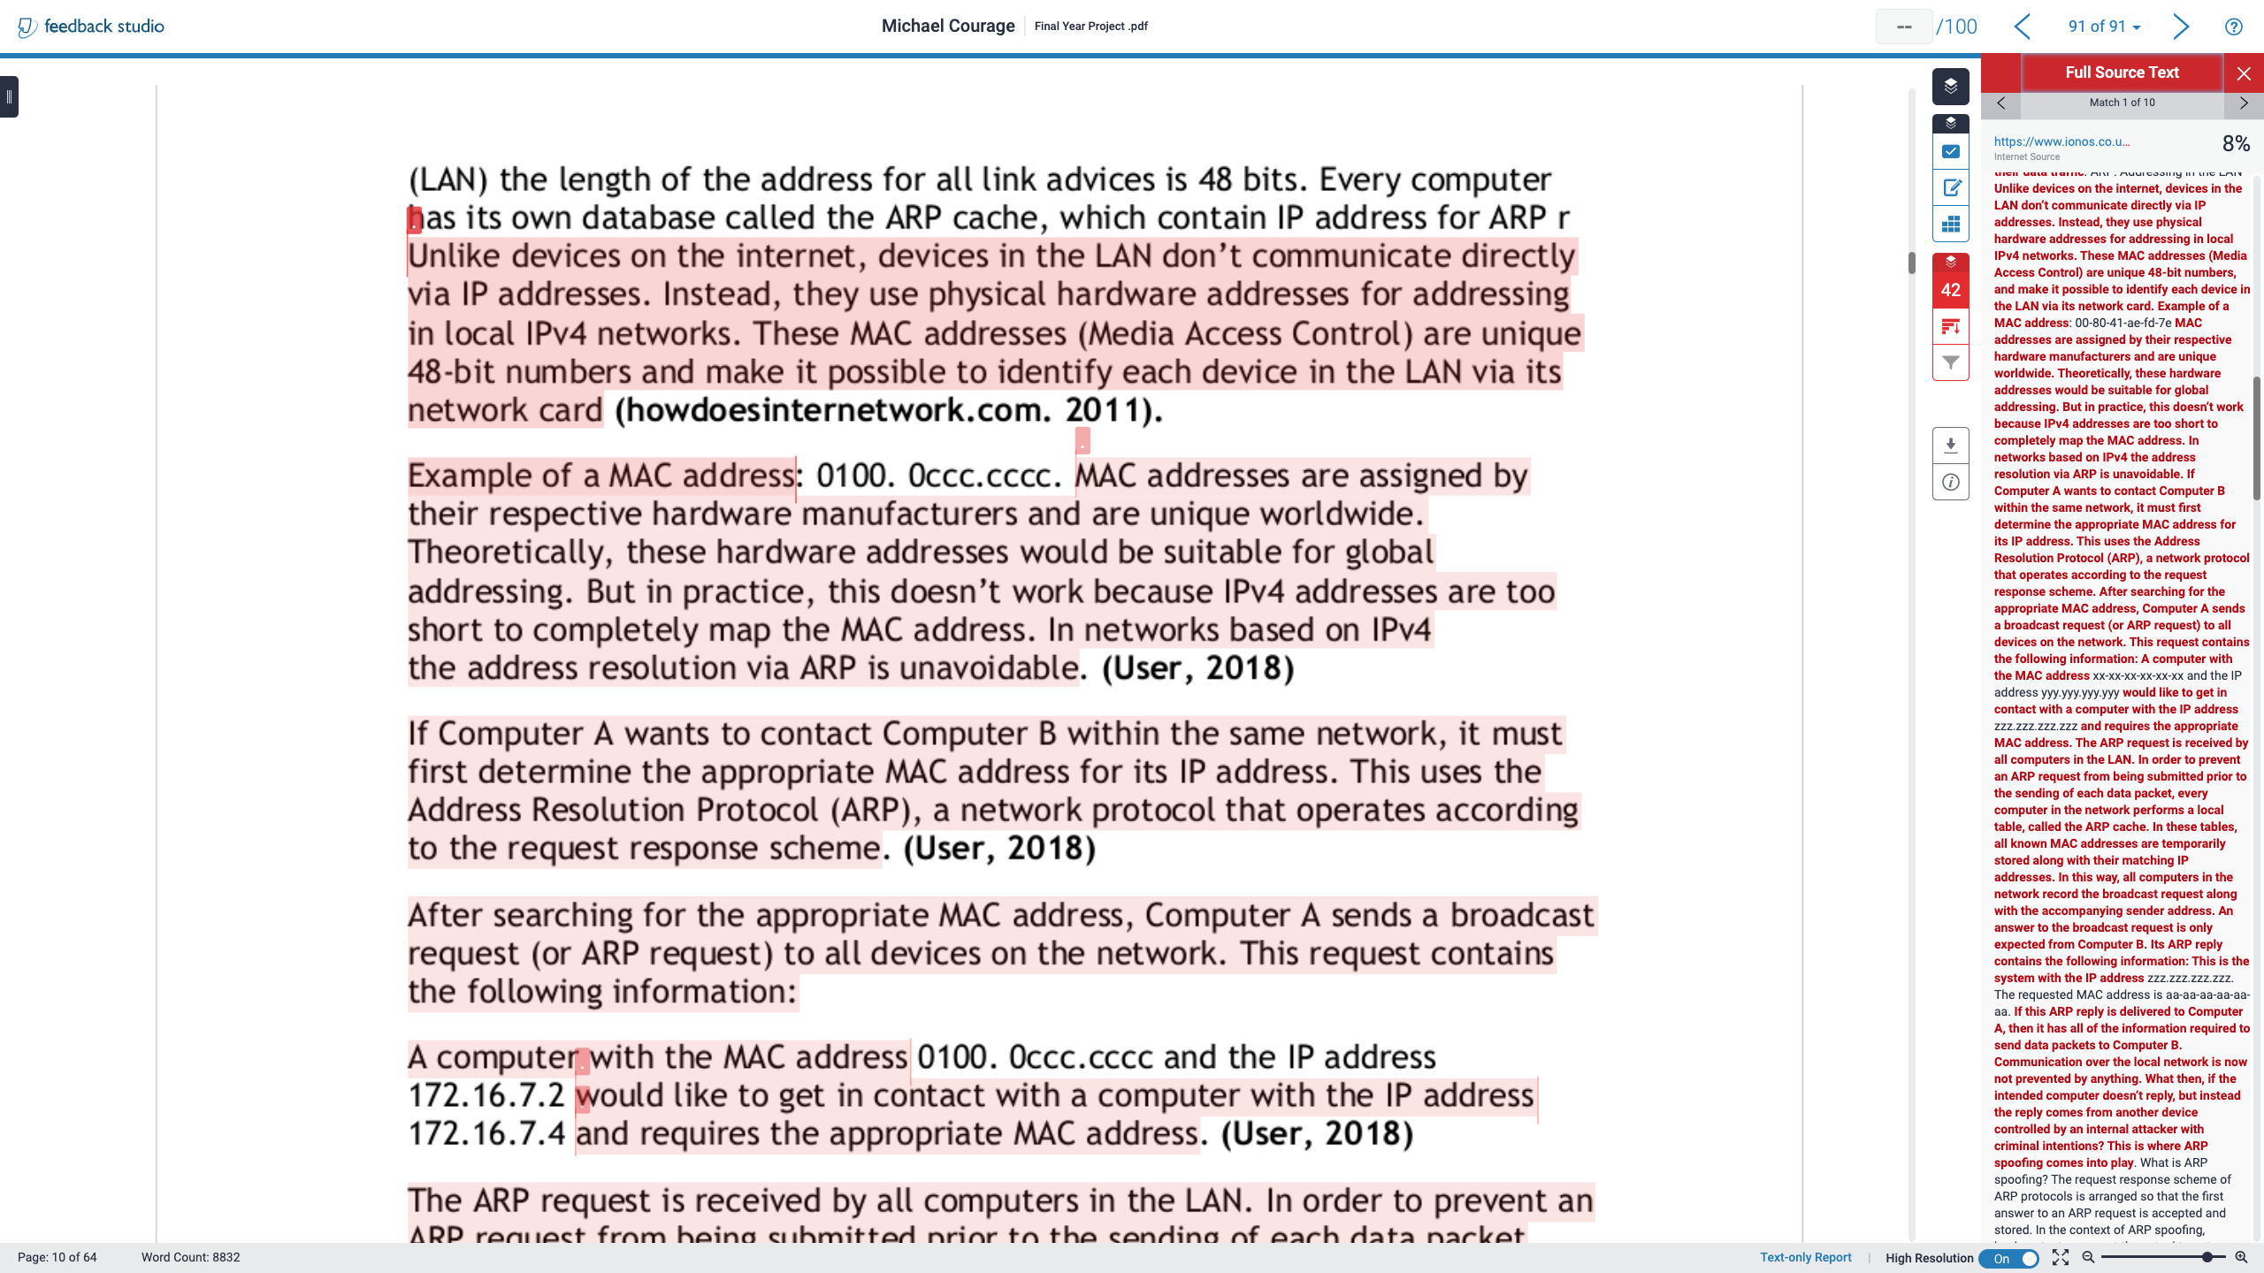

Slide 24
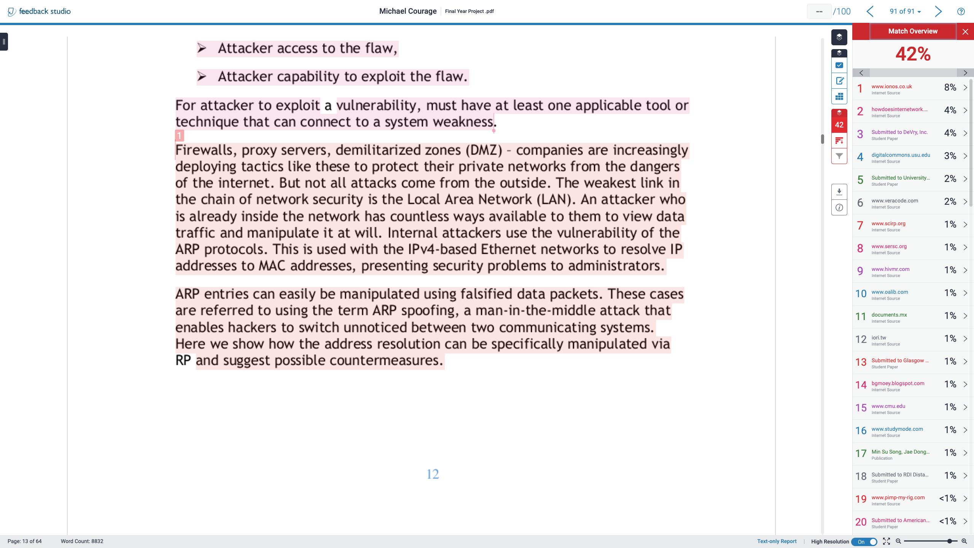

Slide 25
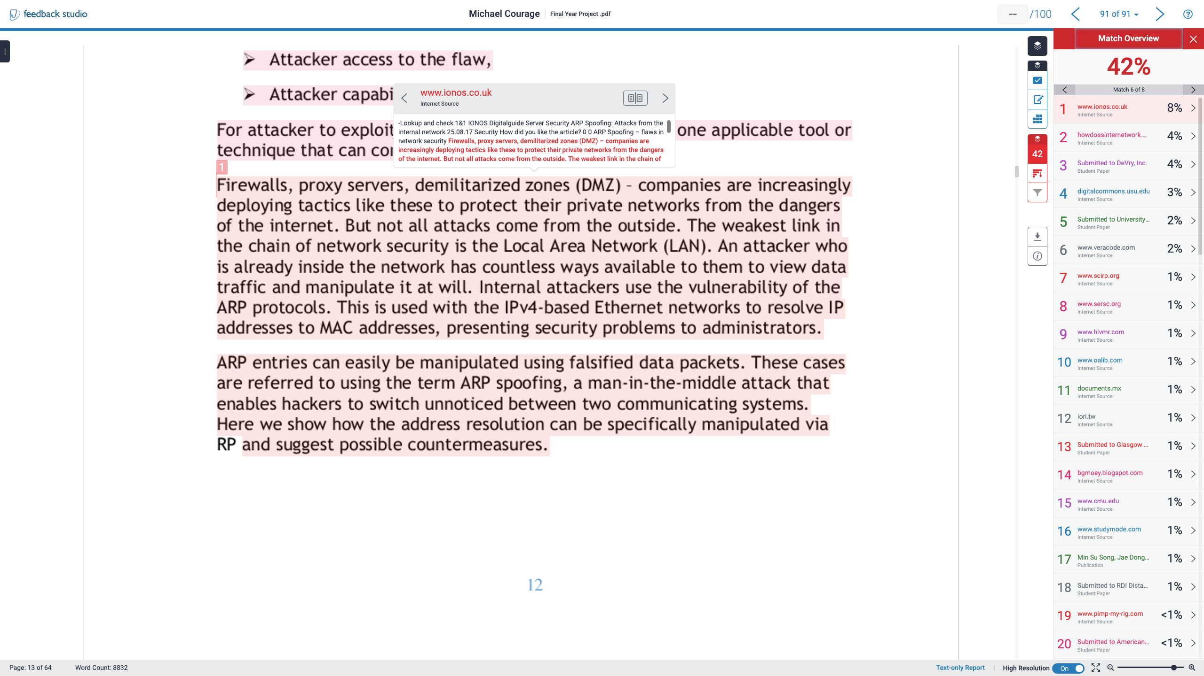

Slide 26
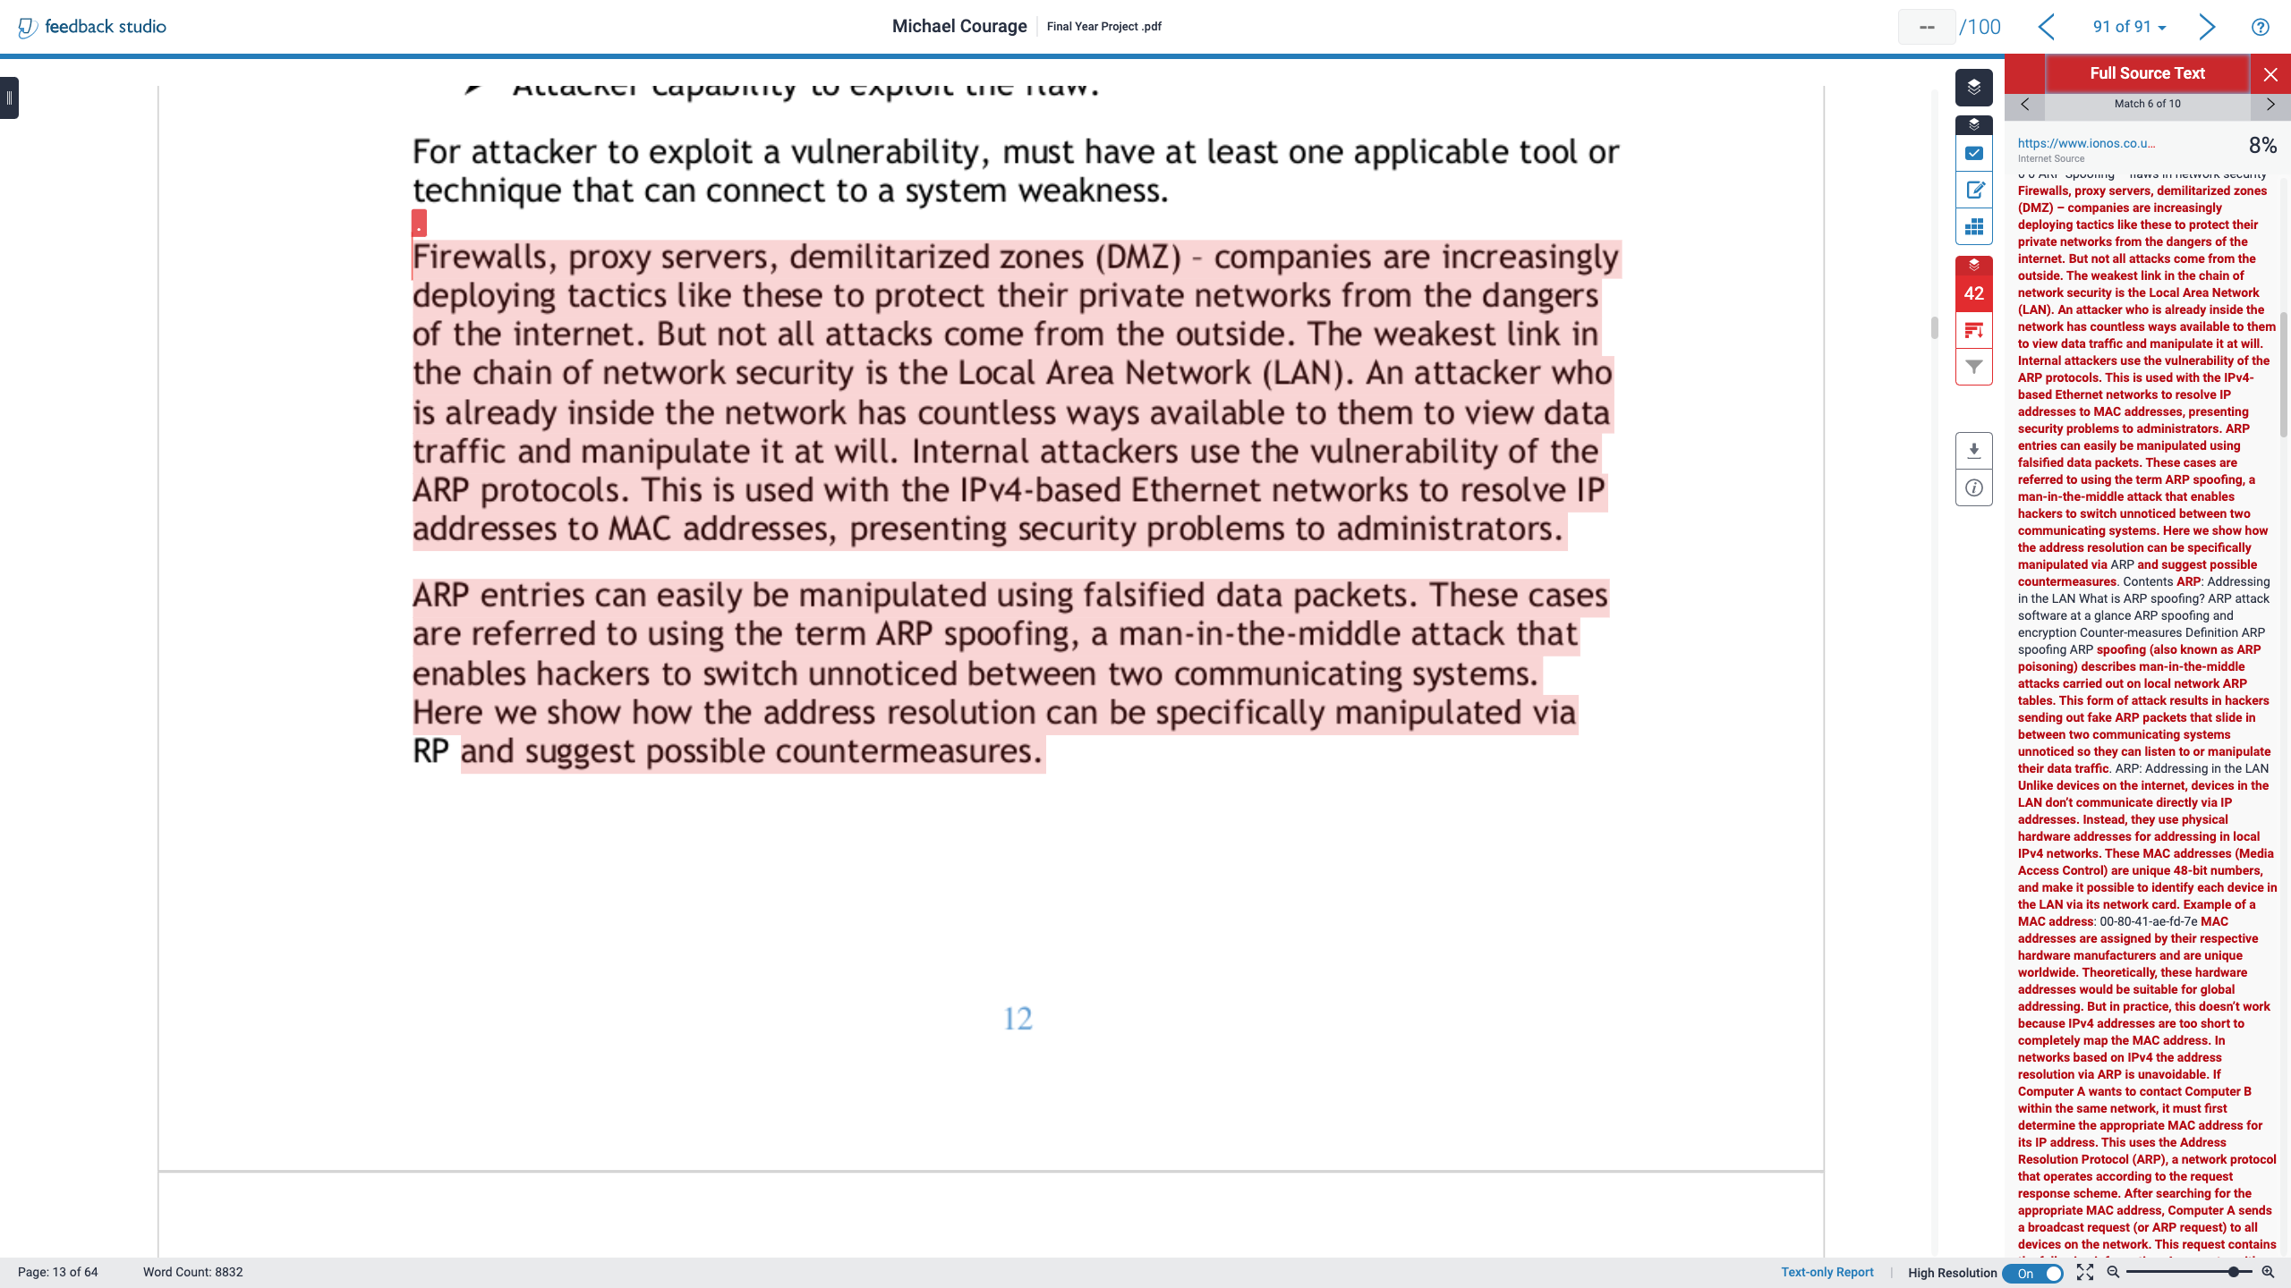

Slide 27
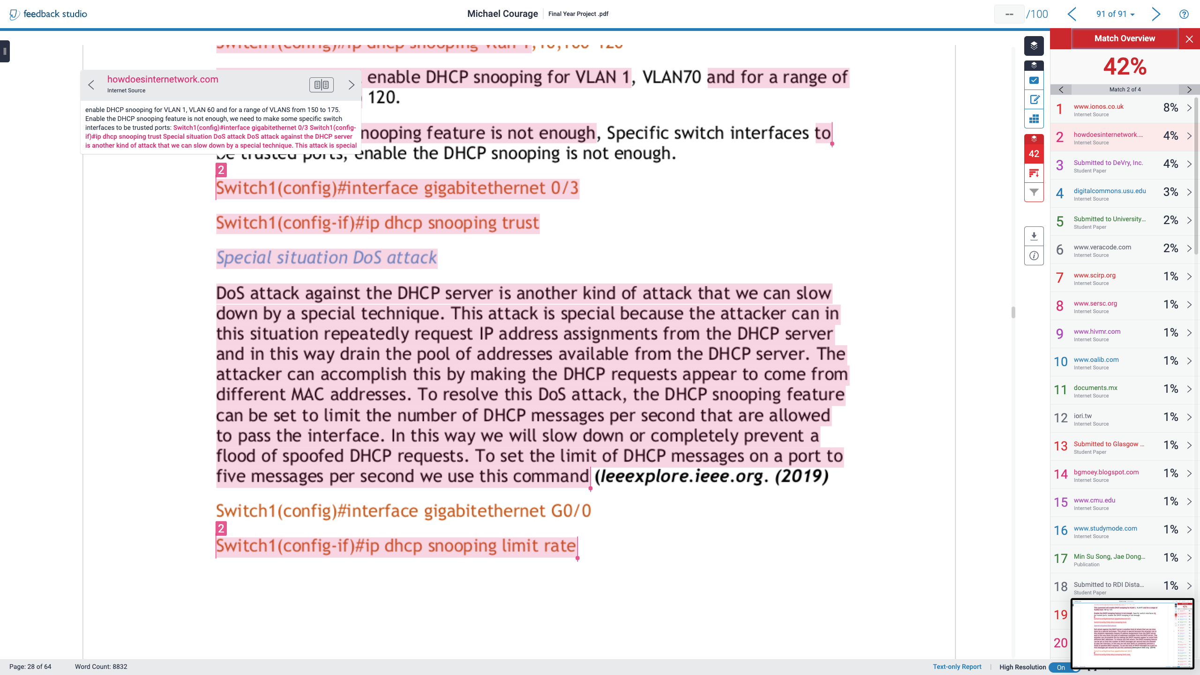

Slide 28
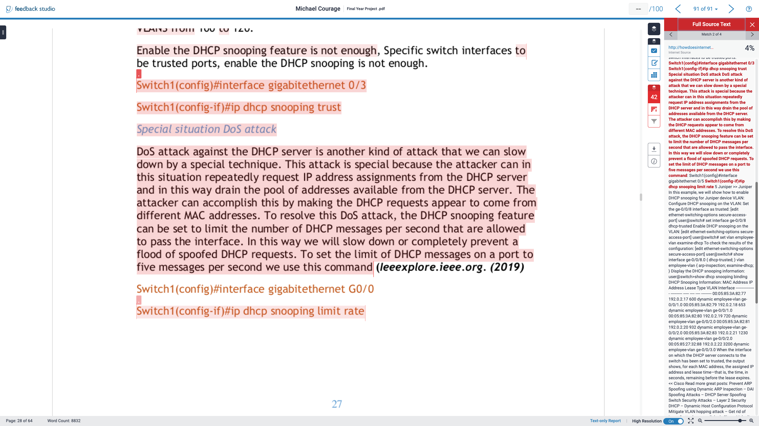

Slide 29
REFERENCES
SOLENT UNIVERSITY., n.d. A guide to interpreting Turnitin originality reports [viewed 29 April 2020]. Available from: https://portal.solent.ac.uk/support/official-documents/information-for-students/complaints-conduct/resources/students-and-staff/guide-interpreting-turnitin-originality-reports.pdf?t=1588260062669
SOLENT UNIVERSITY., 2020. Submitting assignments online: Using the originality report in Turnitin [viewed 29 April 2020]. Available from: https://learn.solent.ac.uk/mod/book/view.php?id=370077&chapterid=163816
TURNITIN., 2019. Interpreting the Turnitin Similarity Report [film] [viewed 29 April 2020]. Available from: https://www.youtube.com/watch?v=gMZLHYplMxA
TURNITIN., 2020. Viewing similarity matches [viewed 28 April 2020]. Available from: https://help.turnitin.com/feedback-studio/turnitin-website/instructor/the-similarity-report/viewing-similarity-matches.htm

